Slide 1
NLP

Slide 2
Machine Translation
Evaluation of Machine Translation

Slide 3
Evaluation
Human judgments
adequacy
grammaticality
[expensive]
Automatic methods
Edit cost (at the word, character, or minute level)
BLEU (Papineni et al. 2002)

Slide 4
BLEU
Simple n-gram precision
log BLEU = min (0,1-reflen/candlen) + mean of log precisions
Multiple human references
Brevity penalty
Correlates with human assessments of automatic systems
Doesn’t correlate well when comparing human and automatic translations

Slide 5
Example from MTC
Chinese:
Napster执行长希尔柏斯辞职
English
Napster CEO Hilbers Resigns
Napster CEO Hilbers resigned
Napster Chief Executive Hilbers Resigns
Napster CEO Konrad Hilbers resigns
Full text
http://clair.si.umich.edu/~radev/nlp/mtc/

Slide 6
“Good” Compared to What?
Idea #1: a human translation.
OK, but
Good translations can be very dissimilar
We’d need to find hidden features (e.g. alignments)
Idea #2: other top n translations (the “n-best list”).
Better in practice, but
Many entries in n-best list are the same apart from hidden links
Compare with a loss function L
0/1: wrong or right; equal to reference or not
Task-specific metrics (word error rate, BLEU, …)
[Example from Schafer&Smith 2006]

Slide 7
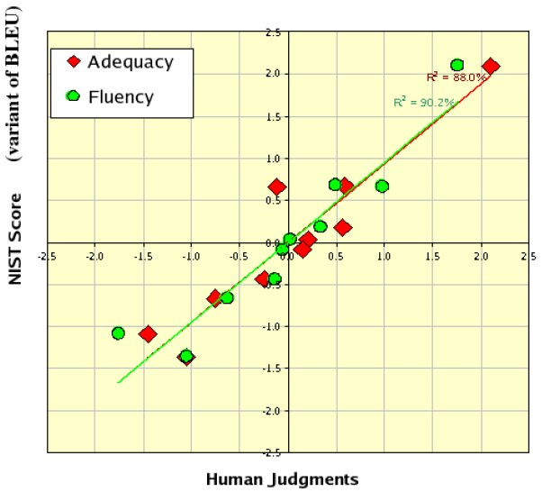
Correlation: BLEU and Humans
[Example from Doddington 2002]

Slide 8
Tools for Machine Translation
Language modeling toolkits
SRILM, CMULM
Translation systems
Giza++, Moses
Decoders
Pharaoh

Slide 9
Machine Translation
Phrase Based Translation

Slide 10
Phrase Alignment Example
Spanish to English
 | Maria | no | dio | una | bofetada | a | la | bruja | verde
Mary | XXXX
did |  | XX
not |  | XX
slap |  |  |  |  | XXXXXX
the |  |  |  |  |  |  | XX
green |  |  |  |  |  |  |  |  | XXXX
witch |  |  |  |  |  |  |  | XXXXX

Slide 11
Phrase Alignment Example
Spanish to English
 | Maria | no | dio | una | bofetada | a | la | bruja | verde
Mary | XXXX
did |  |  |  |  |  | XX
not |  | XX
slap |  |  | XXX | XXX | XXXXXX
the |  |  |  |  |  |  | XX
green |  |  |  |  |  |  |  |  | XXXX
witch |  |  |  |  |  |  |  | XXXXX

Slide 12
Phrase Alignment Example
Intersection
 | Maria | no | dio | una | bofetada | a | la | bruja | verde
Mary | XXXX
did
not |  | XX
slap |  |  |  |  | XXXXXX
the |  |  |  |  |  |  | XX
green |  |  |  |  |  |  |  |  | XXXX
witch |  |  |  |  |  |  |  | XXXXX

Slide 13
Phrase Alignment Example
Combine alignments from union
 | Maria | no | dio | una | bofetada | a | la | bruja | verde
Mary | XXXX
did |  | XX
not |  | XX
slap |  |  | XXX | XXX | XXXXXX
the |  |  |  |  |  | XX | XX
green |  |  |  |  |  |  |  |  | XXXX
witch |  |  |  |  |  |  |  | XXXXX

Slide 14
Search in Phrase Models
One segmentation out of 4096
Deshalb
haben
wir
allen
Grund
,
die
Umwelt
in
die
Agrarpolitik
zu
integrieren
One phrase translation out of 581
That is why we have
every reason
to
integrate
the environment
in
the
agricultural policy
One reordering out of 40,320
Translate in target language order to ease language modeling.

Slide 15
Search in Phrase Models
Deshalb | haben | wir | allen | Grund | , | die | Umwelt | in | die | Agrarpolitik | zu | integrieren
that is why we have |  |  | every reason |  | the environment |  |  | in | the | agricultural policy | to | integrate
therefore | have | we | every reason |  |  | the | environment | in the |  | agricultural policy , | to integrate
that is why | we have |  | all | reason | , | which | environment in |  | agricultural policy |  | parliament
have therefore |  | us | all the | reason |  | of the | environment into |  | the agricultural policy |  | successfully integrated
hence |  | , we | every | reason to make |  |  | environmental | on | the cap |  | be woven together
we have therefore |  |  | everyone | grounds for taking the |  |  | the environment | to the |  | agricultural policy is | on | parliament
so | , we |  | all of | cause | which |  | environment , | to | the cap , |  | for | incorporated
hence our |  |  | any | why | that |  | outside | at | agricultural policy |  | too | woven together
therefore , |  | it | of all | reason for | , the |  | completion | into | that agricultural policy |  | be
And many, many more…even before reordering

Slide 16
Search in Phrase Models
Many ways of segmenting source
Many ways of translating each segment
Restrict phrases > e.g. 7 words, long-distance reordering
Prune away unpromising partial translations or we’ll run out of space and/or run too long
How to compare partial translations?
Some start with easy stuff: “in”, “das”, ...
Some with hard stuff: “Agrarpolitik”, “Entscheidungsproblem”, …

Slide 17
Phrase-based Translation Models
Segmentation of the target sentence
Translation of each phrase
Rearrange the translated phrases

Slide 18
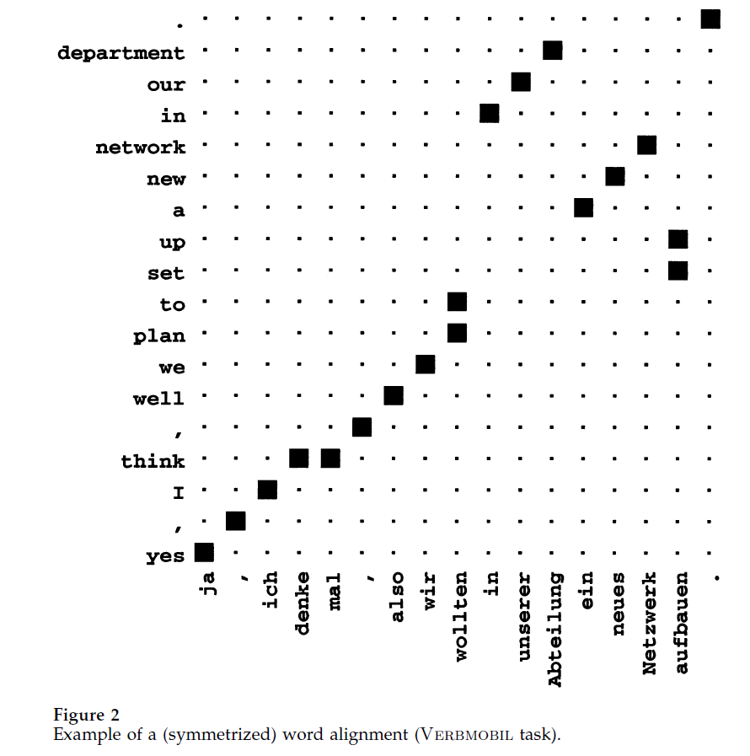
Alignment Templates

Slide 19
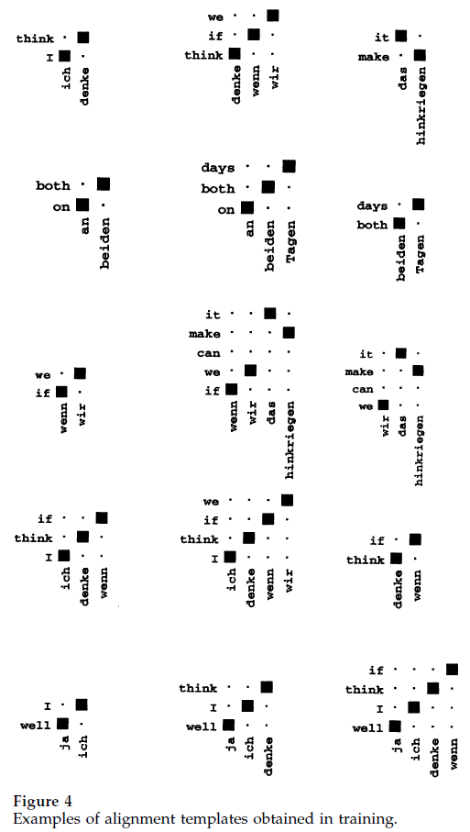
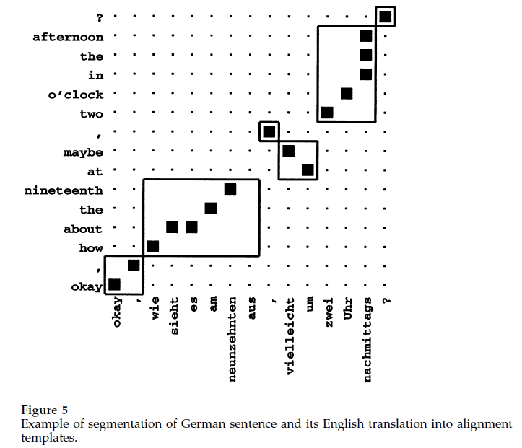
Alignment Templates
[Example from Och/Ney 2002]

Slide 20
NLP

